Slide 1
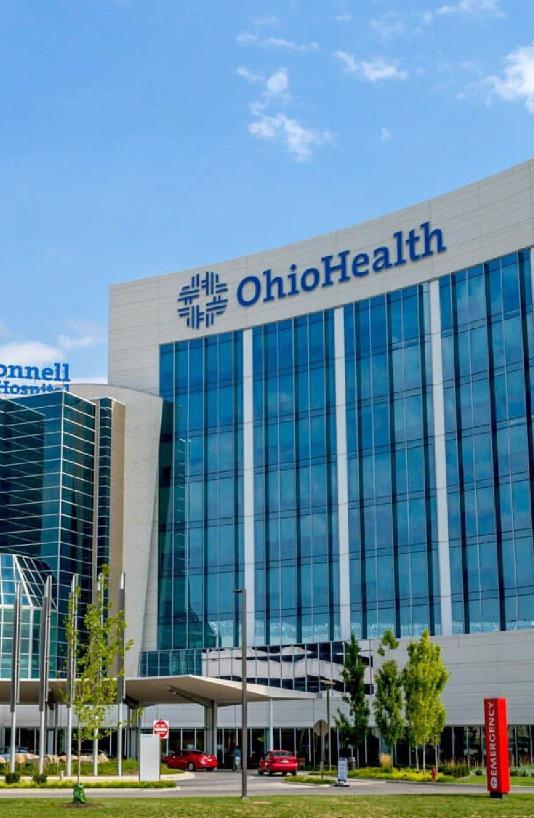


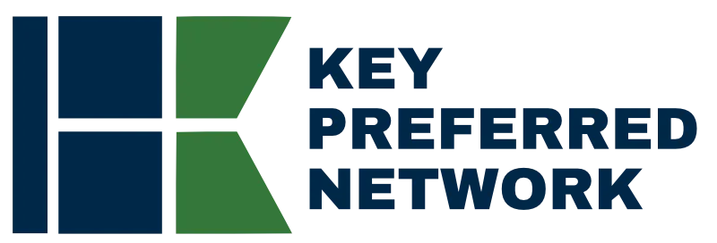
Direct-to-Employer
Go-to-Market Strategy
OPPORTUNITY REVIEW | NOVEMBER 2026
Exploring an OhioHealth direct-to-employer health plan within Ohio's statewide Key Preferred Network
Prepared for
Statewide network

Slide 2



Ohio is ready for a statewide direct-to-employer network
EXECUTIVE SUMMARY
A statewide network is forming
Two ways for OhioHealth to participate
Steerage without restricting choice
KBA is already working with University Hospitals in Northeast Ohio and The Christ Hospital in Southwest Ohio on a statewide plan. OhioHealth completes Central and Southeast Ohio.
Launch an OhioHealth-branded plan built on Key Preferred's broad statewide contracts, or join Key Preferred as the preferred health system for its region.
Key Preferred Benefits reward members for using preferred systems, while the broad network lets them go anywhere. KBA networks average 83% Tier 1 steerage.
$20.6M
Projected Year 4 net margin change for OhioHealth
Target case for an OhioHealth-branded plan: 18,600 members, 67% inpatient and 58% outpatient steerage, 26.4% commercial margin

Slide 3

A national leader in self-funded plans
ABOUT KEY BENEFIT ADMINISTRATORS
1979
3,000+
Founded in Indianapolis
Corporate clients
3M
700
Members under management
Employees
Largest independently owned full-service third-party administrator
Specialists in self-funded plan administration and population health management
A leader in the direct-to-employer movement
Works with every professional team: agents, networks and MGAs
The Key Family of Companies is a vertically integrated group of benefit organizations

Slide 4
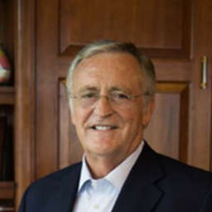
46 years of striving for honesty in healthcare
OUR FOUNDING AND HERITAGE
1979
1985
1992
Today
Founded KBA
Partnered with BCBS
Reacquired KBA
Largest independent TPA
After co-founding a life insurance agency in 1973 and Key Life Insurance in 1976, Larry Dust launched KBA as a TPA focused on honest healthcare delivery.
Sold to Blue Cross Blue Shield of Indiana, gaining capital and market access while keeping operational independence.
Larry bought the business back, returning it to full independence and a patient-focused mission.
KBA is the country's largest independently owned TPA, managing millions of members across diverse markets.
Larry Dust
Founder, Key Benefit Administrators
Never forgotten who gives healthcare
KBA has never participated in reference-based pricing, does not take refunds, and delivers healthcare at 11% below market rates. Our commitment remains with providers and patients, not profit extraction.

Slide 5
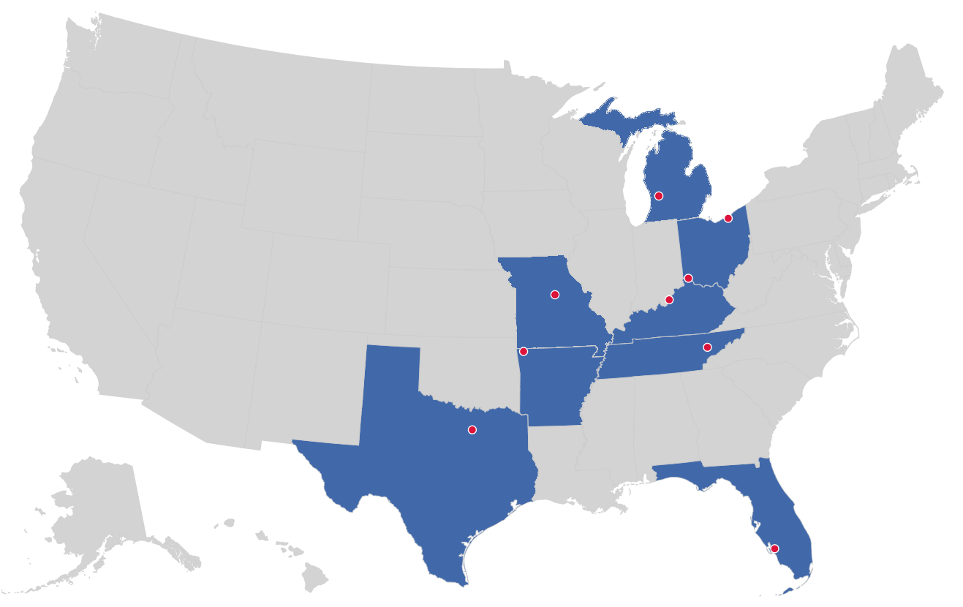


Market leader in private-labeled DTE plans
TRACK RECORD
Private-labeled DTE markets
Cleveland, OH
Cincinnati, OH
Grand Rapids, MI
Columbia, MO
Louisville, KY
Knoxville, TN
Bentonville, AR
Dallas-Fort Worth, TX
Fort Myers, FL
Already active in two Ohio markets

Slide 6
Ohio is different: one statewide network, two ways in
01
How OhioHealth fits alongside University Hospitals and The Christ Hospital in the Key Preferred Network

Slide 7
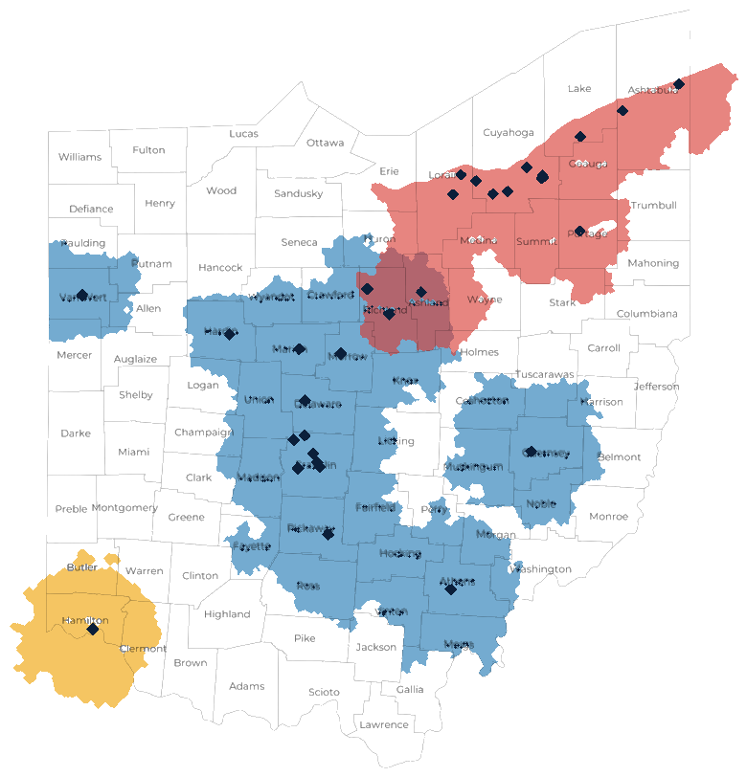

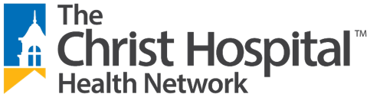
Three anchor systems, three largest Ohio metros
OHIO STATEWIDE STRATEGY
WORKING WITH KBA TODAY
Northeast Ohio: Cleveland, Akron and the Lake Erie corridor to Ashtabula
THE OPPORTUNITY
Central and Southeast Ohio: Columbus, Mansfield, Marion, Athens, Cambridge and Van Wert
WORKING WITH KBA TODAY
Southwest Ohio: Greater Cincinnati
Complementary footprints. The systems overlap only around Mansfield and Ashland, so each can be the clear preferred choice in its own region. Toledo, Dayton and Canton-Youngstown remain open for future preferred partners.

Slide 8



Not a typical PPO: steer to preferred, keep choice
HOW KEY PREFERRED WORKS
BROAD NETWORK
Steer with rewards, not restrictions
Members can see any provider in the broad statewide network
Preferred Plus Benefits, the Health Guardian Account and a 0% Convenience Card can take a member's out-of-pocket cost to $0 at a preferred system.
KEY PREFERRED BENEFITS
Preferred health systems, where members get the richest benefits
Keep freedom of choice
Members can still use any provider in the broad network, which makes the plan easy for employers and brokers to say yes to.
University Hospitals
OhioHealth
EPO-like steerage inside a PPO
The Christ Hospital
KBA's DTE networks average 83% Tier 1 steerage, against OhioHealth's estimated 34% inpatient market share today.

Slide 9


Two ways for OhioHealth to participate
YOUR CHOICE
PATH A
PATH B
An OhioHealth-branded plan, powered by Key Preferred
Join Key Preferred as a preferred system
HOW IT WORKS
OhioHealth launches its own DTE plan as the preferred tier. Key Preferred's broad statewide contracts give members access everywhere else.
HOW IT WORKS
OhioHealth becomes the preferred system for Central and Southeast Ohio inside the statewide plan, next to UH and The Christ Hospital.
BRAND
OhioHealth names the plan and owns the employer relationship.
BRAND
OhioHealth is featured as a preferred system in a statewide plan.
ECONOMICS
OhioHealth sets the fees and keeps the plan profits.
ECONOMICS
Steered volume from every Key Preferred employer with members in OhioHealth's region.
BEST FIT IF
OhioHealth wants a flagship branded product and full control.
BEST FIT IF
OhioHealth wants statewide employer reach and a faster start on an existing plan.
The financial projections in this deck model Path A. Both paths use the same KBA administration, Key Preferred Benefits and statewide broad network.

Slide 10




A statewide plan opens doors a regional plan cannot
WHY STATEWIDE MATTERS
Employers with Ohio-wide workforces
Volume from outside the home market
A Columbus employer with staff in Cleveland and Cincinnati can offer one plan with a preferred system in every region.
Employers headquartered in Cleveland or Cincinnati steer their Central Ohio employees to OhioHealth.
One product for brokers
A stronger competitive position
Brokers sell a single statewide offering instead of three regional plans, which shortens the sales cycle.
Three respected systems together give employers a credible alternative to national carrier networks across Ohio.

Slide 11
The direct-to-employer model
02
A health plan built on a direct relationship with self-funded employers in OhioHealth's market

Slide 12


Your health plan, your market, your margin
DIRECT-TO-EMPLOYER (DTE)
YOU pick the name of the health plan
YOUR PLAN NAME HERE
YOU determine the fees charged
OhioHealth Employer Health Plan
YOU practice the medicine
Preferred system: OhioHealth
Statewide access: Key Preferred Network
Administered by Key Benefit Administrators
YOU receive the profits
WE make it successful
Illustration only. Under Path A, OhioHealth chooses the plan name and brand.

Slide 13








Powerful employer value
DIRECT-TO-EMPLOYER STRATEGY
Lower medical spend through lower unit costs and better integrated care
A seat "at the table" with OhioHealth
Aligned financial incentives
Complete transparency into plan expenses and cost drivers
Aggressive stop-loss premiums and policy terms
Higher employee satisfaction
Better cash flow and a more stable future cost trend

Slide 14
KBA plans average 25 employer groups in two years
PROVEN ADOPTION
25
average employer groups per plan within the first two years
22,700
lives across these four plans in their first two years

Slide 15



Only available to premier health systems
DIRECT-TO-EMPLOYER STRATEGY
STRONG
EXTENSIVE
Brand quality
Patient access
OhioHealth meets every criterion
AFFORDABLE
EXCELLENT
Value pricing
Care quality

Slide 16
Market opportunity and projections
03
What an OhioHealth-branded plan could deliver in OhioHealth's service area

Slide 17
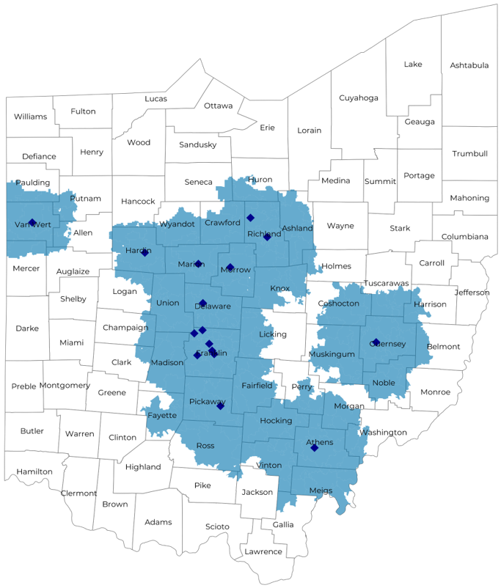
Significant room for plan growth
MARKET OPPORTUNITY
3,500+
800,000+
1,500,000+
Employers
Employees
Members
Commercial employers headquartered in the OhioHealth catchment area, by employer size (number of employees)
 | 50-100 | 101-200 | 201-400 | 401-1,000 | 1,001-3,000 | 3,000+
Employers | 1,995 | 900 | 565 | 300 | 111 | 79
Employees | 149,600 | 135,000 | 169,500 | 210,000 | 222,000 | 474,000
Members | 269,300 | 243,000 | 305,100 | 378,000 | 399,600 | 853,200

Slide 18
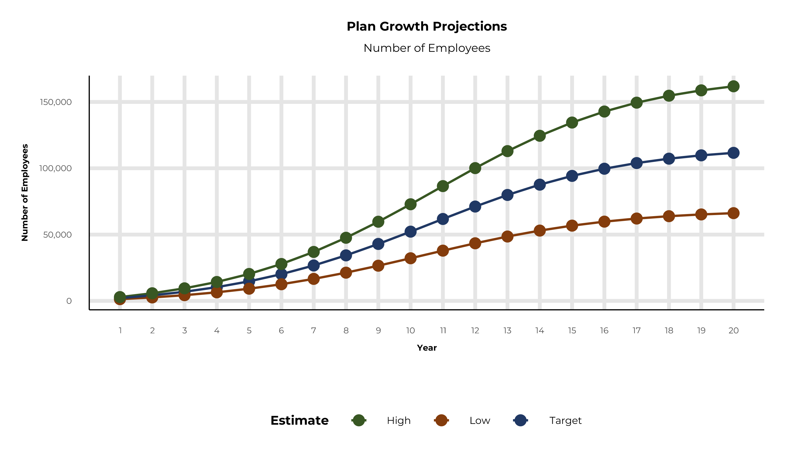
Plan potential growth paths
MARKET OPPORTUNITY
Population
2,585K
Working age
1,546K
Insured
1,091K
Self-funded
765K
Service area includes Allen, Ashland, Athens, Champaign, Coshocton, Crawford, Delaware, Fairfield, Franklin, Guernsey, Hardin, Harrison, Hocking, Huron, Knox, Licking, Madison, Marion, Meigs, Mercer, Morgan, Morrow, Muskingum, Noble, Perry, Pickaway, Richland, Ross, Tuscarawas, Union, Van Wert, Vinton, Washington and Wyandot counties.

Slide 19
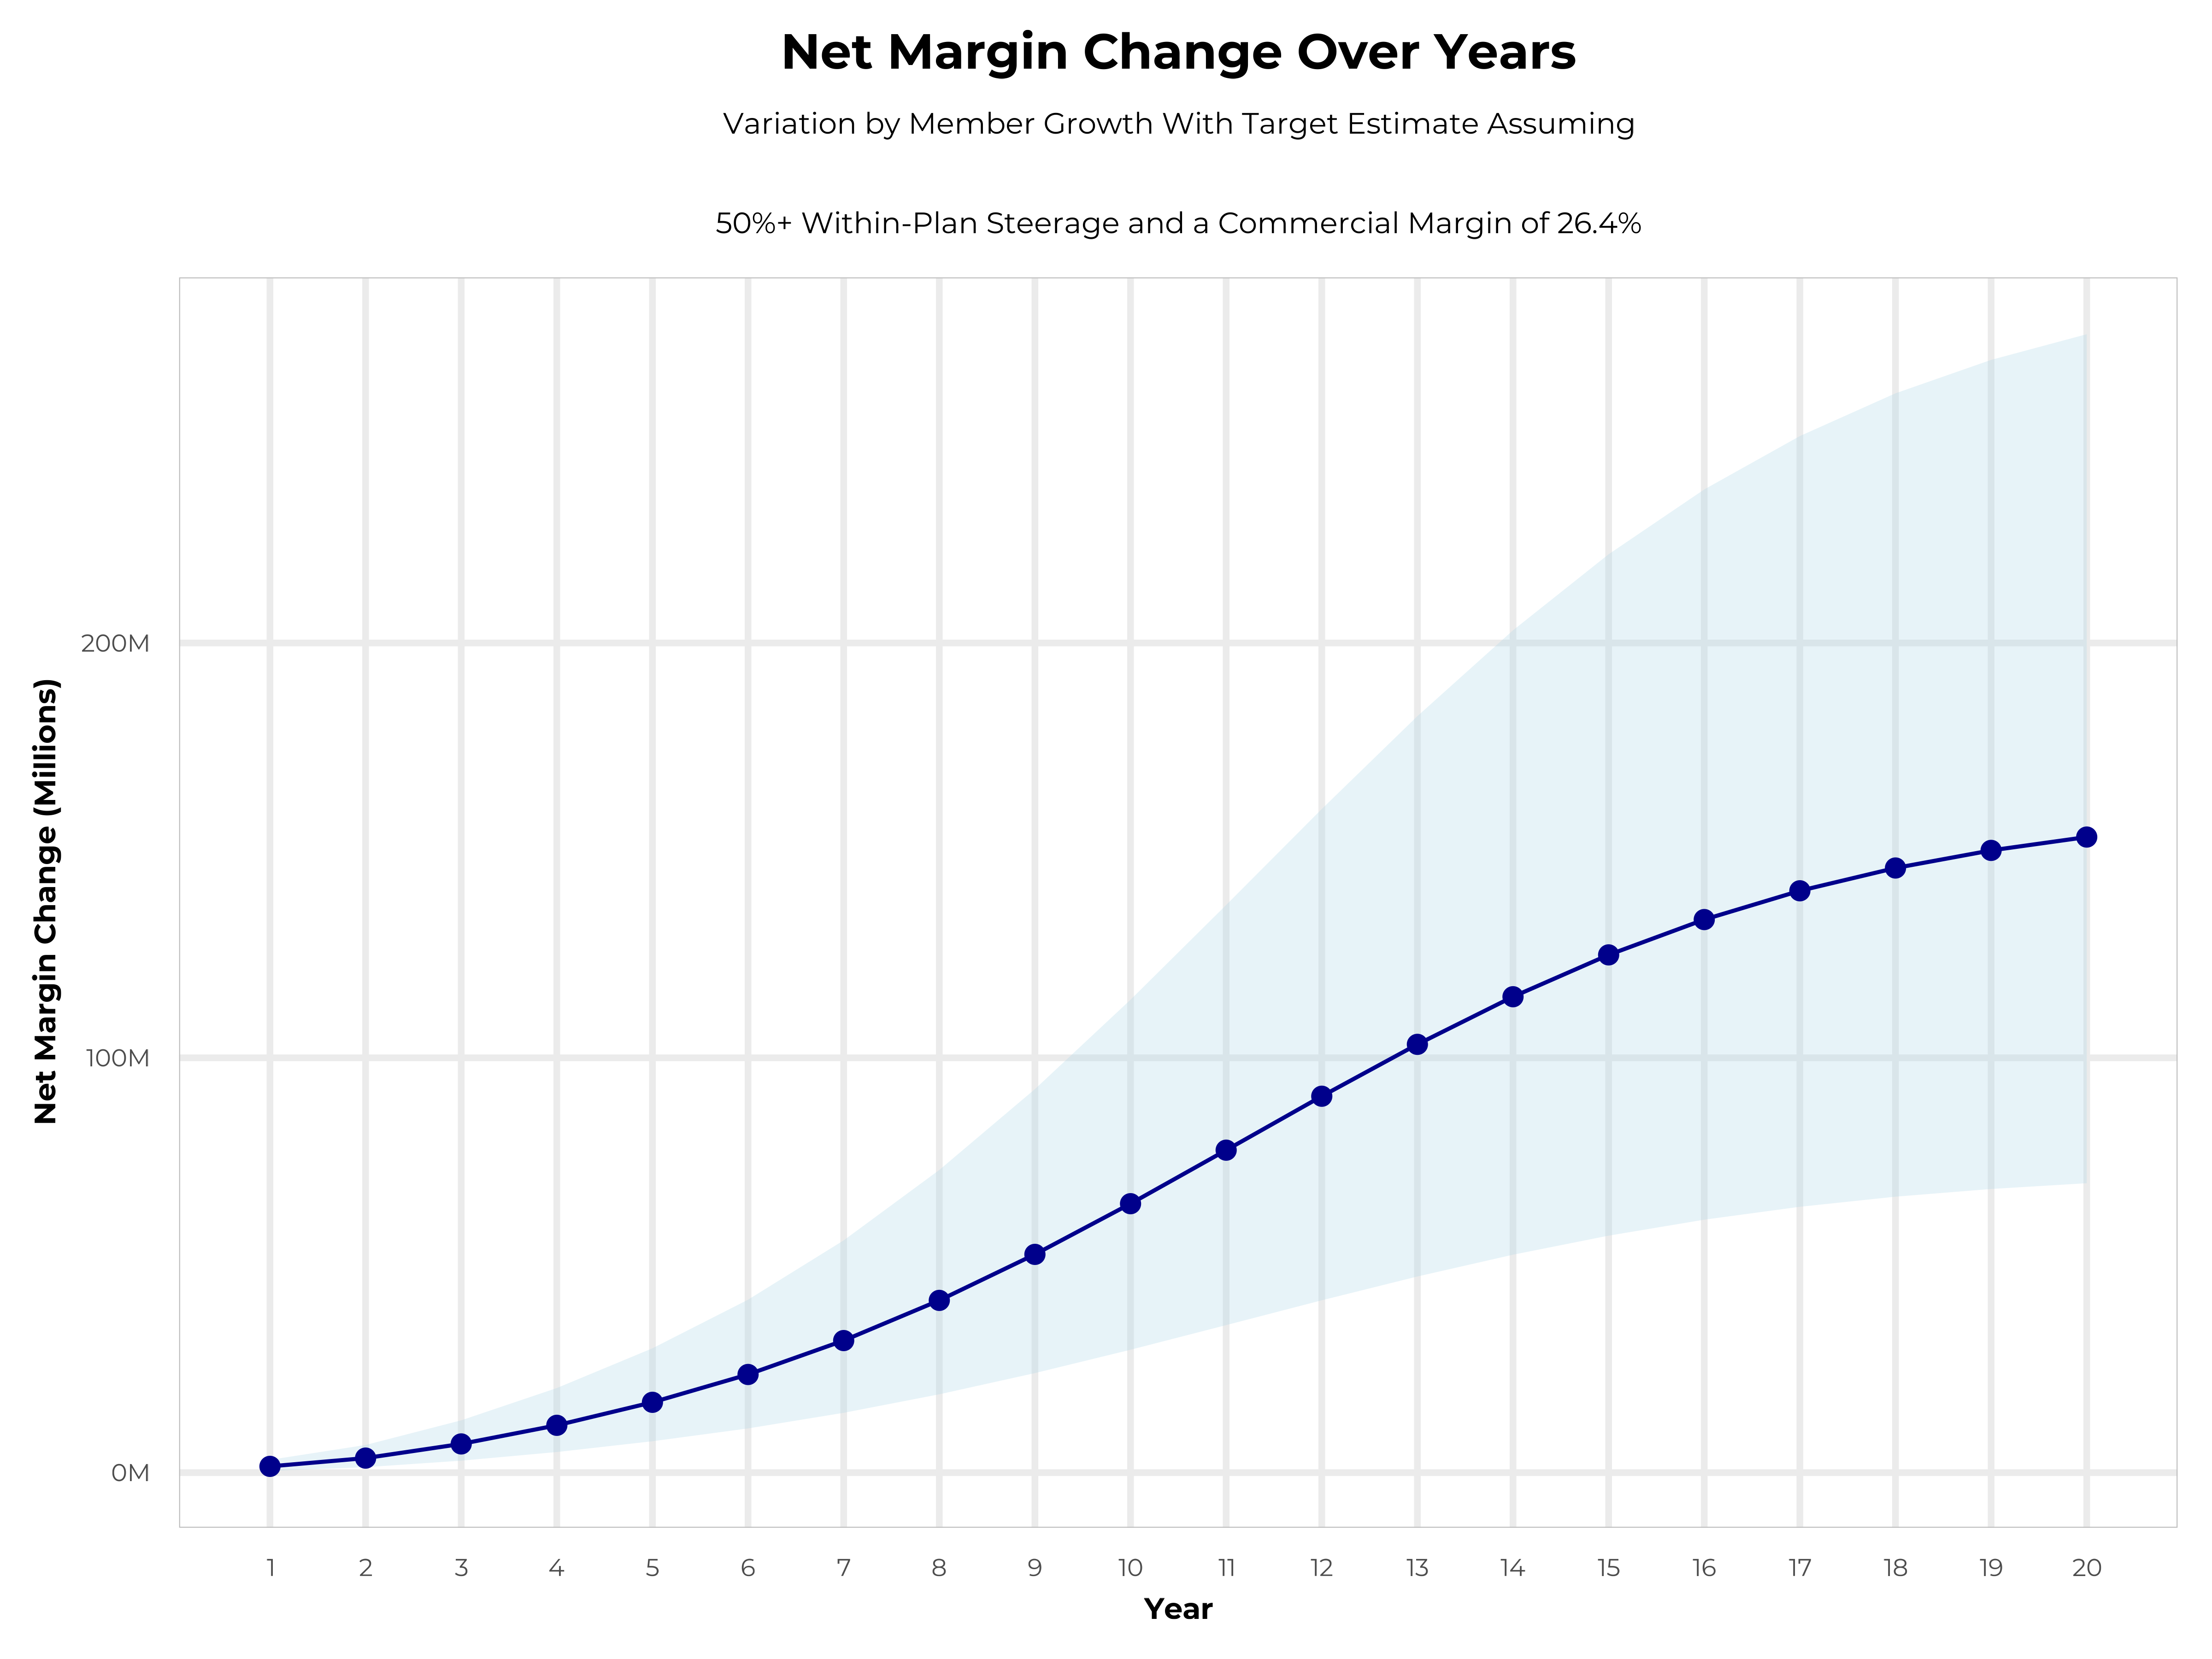
Growing powerful, lasting profitability
LONG-TERM ECONOMICS
Early stage
Gaining name recognition, early growth
New revenue
$40.28M
New profit
$10.66M
Growth stage
Strong reputation, strong growth
New revenue
$246.18M
New profit
$66.08M
Mature stage
High profitability, market saturation
New revenue
$512.03M
New profit
$137.44M

Slide 20
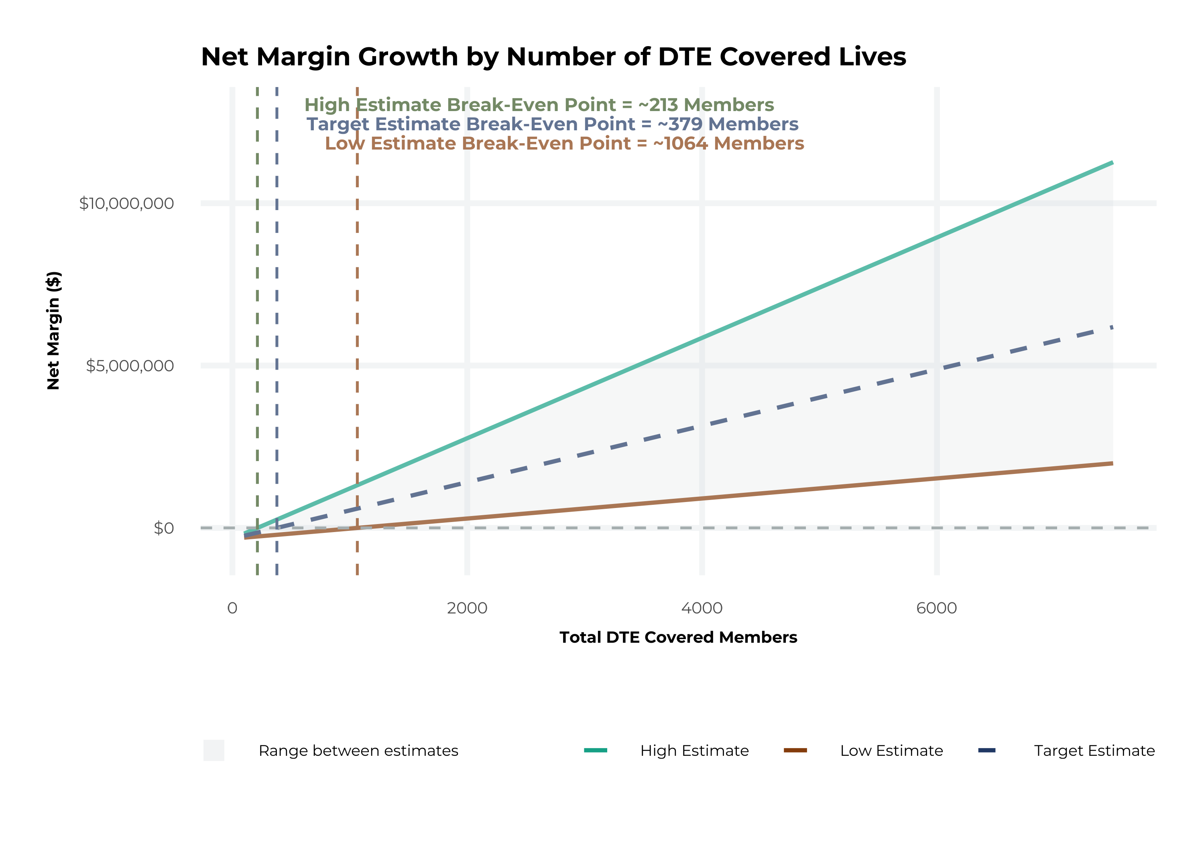
Model assumptions and break-even
MODEL ASSUMPTIONS
Patient steerage
KBA estimates OhioHealth has 34% inpatient and 22% outpatient market share in its service area. The tiered DTE design creates immediate steerage, with more over time from member bonus benefits and the Convenience Card.
Low
10% below target
High
10% above target
Commercial margin
KBA observes a 33% OhioHealth commercial margin. We conservatively model DTE pricing 10% below market, offset by a 10 point gain from friendlier billing and better patient collections.
Low
21.4%
Target
26.4%
High
31.4%

Slide 21
Net margin change grows to $20.6M by Year 4
FOUR-YEAR PROJECTIONS
Target case ($K) | Year 1 | Year 2 | Year 3 | Year 4
Number of Members | 3,800 | 7,500 | 12,400 | 18,600
Incremental Margin | 3,301.4K | 6,518.9K | 12,640.4K | 20,592.0K
Network Access Fee | 45.6K | 90.0K | 148.8K | 223.2K
Implementation Fee (One-Time) | -150.0K | 0.0K | 0.0K | 0.0K
Sales and Marketing Costs | -180.0K | -180.0K | -180.0K | -180.0K
Net Margin Change | 3,017.0K | 6,428.9K | 12,609.2K | 20,635.2K
HIGH CASE, YEAR 4
$28.6M
25,700 members
LOW CASE, YEAR 4
$12.8M
11,600 members

Slide 22

Margin impact by number of covered members
SINGLE-YEAR SUMMARY
Target estimate: 50%+ within-plan steerage and a 26.4% commercial margin
DTE Members | Pre-DTE Revenue | Pre-DTE Margin | DTE Revenue | DTE Incr. Revenue | DTE Total Margin | DTE Incr. Margin | Net Margin Less DTE Fees
100 | $294K | $78K | $618K | $325K | $163K | $86K | $-243K
500 | $1,468K | $388K | $3,091K | $1,623K | $816K | $428K | $104K
1,000 | $2,936K | $775K | $6,182K | $3,245K | $1,632K | $857K | $539K
2,500 | $7,340K | $1,938K | $15,454K | $8,114K | $4,080K | $2,142K | $1,842K
10,000 | $29,362K | $7,752K | $61,816K | $32,454K | $16,320K | $8,568K | $8,358K
20,000 | $58,724K | $15,503K | $123,633K | $64,909K | $32,639K | $17,136K | $17,046K
Upside not included: 340B. Projections exclude 340B contribution margin, which could reach $136 PMPM by optimizing 340B through Rx plan design, OhioHealth's approved sites with network integration, and an OhioHealth proprietary PBM program. Detailed analysis is in the appendix.

Slide 23
Steering members to OhioHealth
04
The Key Incentive Plan turns preferred-provider choice into real dollars for members

Slide 24




Affordability without compromise
THE KEY INCENTIVE PLAN
Employers take back control of their healthcare programs while members keep freedom of choice and are rewarded for choosing high-quality, cost-effective care.
Basic medical benefit
Preferred Plus Benefits*
Health Guardian Account
Customized major medical plan with access to a broad network of providers.
Benefits paid at preferred providers: real dollars to members who get the care they need, when they need it.
KBA tracks and administers Preferred Plus Benefits, out-of-pocket expenses and the Convenience Card.
Healthcare Convenience Card
Chronic disease and acute illness management
PBM, specialty Rx and GLP-1 program
0% interest, no-fee card for out-of-pocket expenses at preferred providers.
Patented program covering 28 chronic illnesses with 11% to 17% savings and a $14 to $1 ROI.
Transparent Rx programs with 1-on-1 coaching: about 20%+ savings on Rx and 10% on overall claims.
*Daily inpatient hospital benefit, OP surgery/anesthesia, OP radiology/X-ray, OP diagnostic labs, health screening benefit, wellness benefit, critical illness

Slide 25
Base medical + Preferred Plus: the deductible can vanish
THE KEY INCENTIVE PLAN
Example: a member with a $2,500 deductible and $4,500 out-of-pocket maximum has a heart attack and cardiac surgery with a 5-day inpatient stay. At a preferred provider, $4,925 in Preferred Plus Benefits cover the full $4,500 out-of-pocket, so the member owes $0. At a non-preferred provider, the member owes $4,500.
Base medical benefits*
Deductible (single / family) | $2,500 / $4,500
Coinsurance | 80% / 20%
Max out-of-pocket (single / family) | $4,500 / $9,000
Chronic disease regimens of care | Covered at 100%
Healthcare Convenience Card | 0% interest
Health Guardian Account | Included
Preferred Plus Benefits | Preferred | Non-preferred
OP radiology / X-ray | $200 | $0
OP diagnostic labs | $100 | $0
Preferred hospital stay ($500/day, 5 days) | $2,500 | $0
Critical illness benefit | $2,000 | $0
Health screening benefit | $125 | $0
Total employee out-of-pocket | $4,500 | $4,500
Preferred Plus Benefits | $4,925 | $0
Employee amount due to provider | $0 | $4,500
Added to Health Guardian Account | $425 | $0
*Base medical benefits are for illustration only and can be customized to client needs.

Slide 26

The benefit steers the patient to OhioHealth
WHAT WILL THIS CLAIM COST ME?
Explanation of benefits: heart attack, cardiac surgery
THE CHARGES
Medical bills | $25,000
Out-of-pocket due to provider | $4,500
THE CREDITS
OP radiology / X-ray | $200
OP diagnostic labs | $100
Preferred hospital stay ($500/day, 5 days) | $2,500
Critical illness benefit | $2,000
Health screening benefit | $125
Benefit total | $4,925
Out-of-pocket paid to hospital | ($4,500)
Balance paid to Health Guardian Account | $425
OhioHealth patients can have all out-of-pocket liability reduced to $0

Slide 27

Creating EPO steerage in a PPO network
THE KBA HEALTHCARE CONVENIENCE CARD
The card works only for specific merchant codes, so it rewards care at preferred providers.
1
Use at specific healthcare providers
Designated hospitals, urgent care facilities, physicians and eligible ancillary providers
2
Out-of-pocket expenses qualify
3
0% interest rate
4
Employee sets the repayment schedule
5
Simple to qualify
Answer one simple question

Slide 28
GLP-1s that don't break the bank
WEIGHT MANAGEMENT
Prime Therapeutics reports GLP-1 spend per member per month tripled by March 2025, now about 15% of total pharmacy spend, with more than 1 in 50 members filing a GLP-1 claim in Q1 2025.
THE CHALLENGE
OUR SOLUTION
THE IMPACT
$1,089-$1,349
$249
$7M
per month for traditional GLP-1s, an unsustainable cost that limits employee access
per month for generic GLP-1 medications secured by Key Benefits, with strict budget control
saved by one major city that was spending $11M a year on GLP-1s
Beyond medication: comprehensive care
Members get specialized coaching twice a month on keeping muscle strength, moderate exercise and lasting lifestyle changes that sustain weight loss after GLP-1 treatment ends.
270
conditions linked to obesity (Cleveland Clinic)
$8.5K
added annual cost per obese individual (KFF)

Slide 29
Platform and go-to-market
05
Clinical integration, pharmacy, stop-loss, sales and implementation

Slide 30


Integration with the Epic EHR
CLINICAL INTEGRATION
KBA shares evidence-based standards of care for 27 chronic conditions directly into Epic, so OhioHealth clinicians see gaps in care at the point of care.
Example standard: Hyperthyroidism: yearly clinical evaluation, TSH and T4

Slide 31




The missing piece to value-based care
VALUE-BASED CARE
Patient engagement is the weak link in value-based care. OhioHealth's clinical leadership and employer participation can drive better outcomes.
KBA's proactive care management team supplements OhioHealth's own outreach to patients.
OhioHealth excels in standards-of-care completion for the chronically ill, improving care and cost.
Integrating OhioHealth's managed care with KBA's programs positions OhioHealth as the value leader.

Slide 32


Transparent PBM integration
PHARMACY
OhioHealth-centered pharmacy
Clinical flexibility
Custom client support
Support OhioHealth's retail pharmacies
Optimize OhioHealth's 340B drug pricing program
Option for OhioHealth to create its own PBM program
Custom phone number with personalized scripting and call tracking
Customizable member welcome booklet and materials
White-labeled formulary and marketing materials
Full portfolio of custom formularies with an optimized formulary shield
Clinical programs that advance the overall DTE strategy
More drug savings by moving members to lower-cost alternatives
Customize or layer on utilization management programs
Specialized call center capabilities
Fully customizable plan designs
Operational access to the platform
Processes customized to promote the DTE strategy

Slide 33

The KBA stop-loss experience
STOP-LOSS INSURANCE
20+
$150M+
CARRIER RELATIONSHIPS INCLUDE
stop-loss underwriters and carriers
annual stop-loss premium placed
Tokio Marine
Nationwide
Comprehensive pricing and medical service analysis for every DTE plan ensures proper pricing. KBA provides the administration the stop-loss markets require:
Berkshire Hathaway
Sun Life
Liberty Mutual
Granular (Google)
Bordereau reporting
Claim reporting and reconciliation
Evaluation of networks
Care management
Companion Life
Crum & Forster
Initial underwriting
Negotiation of rates and terms
American Fidelity
RGA
Plan design actuarial

Slide 34





KBA works with you to manage and sell
DTE PROGRAM MARKETING AND SALES
Branding and messaging
Direct and brokerage sales distribution with a focused sales representative
Brochures, website and media
Stop-loss and level-funded options down to 20 employee lives
Sell through established brokers in your service area

Slide 35

A community-based sales strategy
SALES STRATEGY
1
A locally based sales rep with strong community ties
2
Work with DTE provider partners to identify strategic employers for early adoption
3
Partner with select brokers whose incentives and goals are aligned
4
Shared pipeline reporting and collaboration with DTE provider partners
5
Marketing and promotion of the new option in the community

Slide 36





A complete marketing system
MARKETING
Customized branding and messaging
Customized brochures
Customized website
Targeted employer outreach
Sales system: social media, email, text and more
Sample private-label plan website

Slide 37
Everyone at the table wins
COLLABORATION OF STAKEHOLDERS
Key Benefit Administrators
OhioHealth's DTE
Employer
Employee
Full TPA administration
Stop-loss administration
True transparency and analytics
Population health management
Utilization and case management
Sales and marketing
Transparent PBM
Website and mobile app
Customizable options and plans
Incremental revenue and margin
Branding and messaging
Benefit plan integration
Network steerage
Direct relationship with self-funded employers
Referral authorization
Plan transparency
Direct access to members
Reduced spend
"At the table" with OhioHealth
Improved analytics
Complete transparency
Lower stop-loss
Benefit plan stabilization
Healthier population
Reduced out-of-pocket
Improved health
Better coordination and navigation of care
Direct access to the best medical providers

Slide 38
Who does what
ROLES AND RESPONSIBILITIES
OhioHealth
KBA Operations
Tier 1 provider network
Provider recruitment, if necessary
Network pricing and contract terms
Referral management protocols and approvals
Medical director oversight
Practice improvement program using KBA/AHDI data, with KBA assistance
Network evaluation: actuarial pricing
PPO wrap and tertiary transplant network, if needed
Claims administration
Plan design development, testing and administration
Employer, member and provider customer service
Customized member, provider, agent and HR portal
Billing, enrollment and premium management
Fulfillment: SPD and customized ID cards
COBRA/HIPAA administration
Out-of-network negotiations
Wrap PPO repricing
Nurse coaching for the chronically ill
Nurse triage to physicians and facilities
Stop-loss underwriting, pricing and placement
Stop-loss claims administration
Complex case management
PBM administration interface
Reporting: utilization, gaps in care, physician profiling, referrals, chronic disease, employer risk
Ancillary administration: dental, vision, life, 5500 and more
HSA, FSA and HRA administration
Sales and marketing plan: branding, distribution, sales management
KBA Consulting
Program oversight and integration across the enterprise
Goal development, agreement and tracking
Start-up assessments: market, network, operations and readiness
Draft business plan with financial projections
Engagement with OhioHealth's C-suite, operations, HR, managed care, marketing, strategy and business development

Slide 39



Get the network and the pricing right first
PRE-IMPLEMENTATION
STEP 1
STEP 2
Provider file
Pricing
Determine gaps in medical service delivery
Identify other key providers to potentially contract with on behalf of OhioHealth
Wrap the network to cover all other provider types, using Key Preferred's broad statewide contracts
Dial in competitive stop-loss rates and OhioHealth's net revenue and margins
Actuarial evaluation compared to the market

Slide 40

From decision to go-live in 6 to 8 months
IMPLEMENTATION
DECIDE
MONTH 1
MONTHS 1-6
MONTHS 3-6
MONTHS 6-8
Choose a path
Agreement and project scope
Implementation
Sales and marketing
Go live
Branded plan (Path A) or join Key Preferred (Path B)
Market outreach begins in month 3
Hire the sales executive
First employer groups enroll
Recommended next step: a working session with OhioHealth leadership to choose a participation path, confirm the preferred service area, and start the pre-implementation network and pricing analysis.

Slide 41
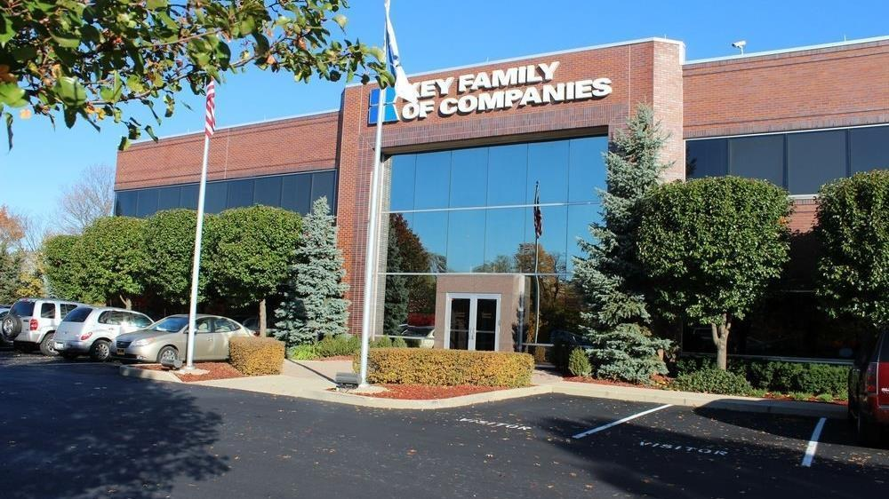

A partner you can trust
Our objectives are aligned
We know the Ohio market
Completely transparent
The sophistication and infrastructure to compete
Derek Moore
Senior Vice President, Key Benefit Administrators
845-283-9973 | derek.moore@keybenefit.com

Slide 42
Appendix: financial projections and assumptions
A
Payer mix, margin, market share, steerage and scenario detail for the OhioHealth-branded plan (Path A)

Slide 43
Estimated OhioHealth 2023 payer mix
APPENDIX
Payer Group | Total Inpatient Days | Revenue | Payer Mix
All OhioHealth | 562,263 | $5,399,076K | 100%
Medicare | 137,889 | $631,316K | 24%
Medicaid | 33,175 | $450,321K | 6%
Other Government Pay | 0 | - | -
No-Pay, Charity Care | 33,959 | -$357,365K | 6%
Commercial/Self Pay | 357,240 | $4,318,736K | 64%
Estimating payer mix
Medicare, Medicaid and other government mixes are each group's inpatient days divided by total inpatient days.
No-pay and charity care is no-pay/charity revenue as a share of total revenue.
Commercial/self-pay is the remainder.
Estimating inpatient days
No-pay and commercial days are their payer mix shares multiplied by total inpatient days.
Outpatient payer mix is assumed to mirror inpatient. Total Medicare revenue is from MedPAR.
Values from the CMS Medicare Provider Cost Report, Definitive Healthcare and MedPAR.

Slide 44
Estimated margin: commercial vs. government pay
APPENDIX
RAND data estimates OhioHealth commercial reimbursement at 300% of Medicare rates.
Commercial margin
Government-pay margin
Counterfactual: all government-pay patients paid at commercial rates
Counterfactual: all commercial patients paid at Medicare rates
Commercial Revenue | $4,318,736K
Gov-pay revenue at 300% current rate | $3,243,260K
Total Revenue | $7,561,996K
Total Costs | $5,032,600K
Net Income | $2,529,396K
Commercial Revenue Divided by 300% | $1,440,311K
Gov-pay revenue | $1,081,637K
Total Revenue | $2,521,949K
Total Costs | $5,032,600K
Net Income | $-2,510,651K
33%
-100%

Slide 45
Estimating market share (1 of 3)
APPENDIX
Hospital | Beds | Inpatient charges | Outpatient charges | IP share | OP share*
OhioHealth Riverside Methodist Hospital | 766 | $3,668,762.9K | $2,224,512.0K | 15% | 5%
OhioHealth Marion General Hospital | 179 | $360,019.4K | $715,340.7K | 1% | 2%
OhioHealth OBleness Hospital | 67 | $109,434.3K | $358,712.5K | <1% | 1%
OhioHealth Grant Medical Center | 551 | $2,124,810.4K | $3,191,154.9K | 8% | 7%
OhioHealth Van Wert Hospital | 27 | $22,972.6K | $109,348.8K | <1% | <1%
OhioHealth Mansfield Hospital | 240 | $697,954.6K | $852,937.6K | 3% | 2%
OhioHealth Doctors Hospital | 174 | $579,743.1K | $675,616.4K | 2% | 1%
Berger Hospital | 83 | $86,914.6K | $324,065.7K | <1% | 1%
OhioHealth Southeastern Medical Center | 86 | $78,920.3K | $218,351.9K | <1% | <1%
OhioHealth Grady Memorial Hospital | 60 | $85,483.2K | $383,263.2K | <1% | 1%
OhioHealth Dublin Methodist Hospital | 110 | $427,777.3K | $738,508.7K | 2% | 2%
Morrow County Hospital | 25 | $5,287.3K | $55,753.7K | <1% | <1%
OhioHealth Hardin Memorial Hospital | 30 | $10,040.0K | $95,091.2K | <1% | <1%
OhioHealth Shelby Hospital | 21 | $19,874.9K | $64,353.2K | <1% | <1%
OhioHealth Rehabilitation Hospital | 139 | $169,877.4K | n/a | 1% | n/a
OhioHealth Rehabilitation Hospital - Dublin | 40 | $39,117.4K | n/a | <1% | n/a
University Hospitals Samaritan Medical Center | 28 | $55,036.2K | $210,964.8K | <1% | <1%
34%
OhioHealth inpatient market share
22%
OhioHealth outpatient market share
OhioHealth facilities in green. *Outpatient share assumes 66% of local physicians are employed by area hospitals (Physician Advocacy Institute, Avalere Physician Employment Trends Study 2019-2023).

Slide 46
Estimating market share (2 of 3)
APPENDIX
Hospital | Beds | Inpatient charges | Outpatient charges | IP share | OP share*
Mount Carmel St Anns | 263 | $945,697.0K | $851,668.4K | 4% | 2%
Mount Carmel East | 363 | $2,229,620.2K | $1,560,111.1K | 9% | 3%
Genesis Hospital | 252 | $715,816.1K | $1,428,636.7K | 3% | 3%
Fairfield Medical Center | 185 | $458,109.7K | $746,201.0K | 2% | 2%
Ohio State University Wexner Medical Center | 1,935 | $4,469,341.2K | $4,885,446.7K | 18% | 11%
Chillicothe VA Medical Center | 91 | n/a | n/a | n/a | n/a
Memorial Hospital | 54 | $106,887.7K | $463,327.3K | <1% | 1%
Coshocton Regional Medical Center | 56 | $67,823.7K | $93,247.9K | <1% | <1%
Adena Regional Medical Center | 237 | $974,117.6K | $1,293,716.6K | 4% | 3%
Madison Health | 45 | $30,658.5K | $230,683.2K | <1% | 1%
The James Cancer Hospital and Solove Research Institute | 356 | $2,192,396.8K | $4,577,080.8K | 9% | 10%
Mount Carmel New Albany | 60 | $124,143.4K | $251,073.0K | <1% | 1%
Diley Ridge Medical Center | 10 | $4,845.0K | $115,396.3K | <1% | <1%
Ontario Hospital | 49 | $69,894.8K | $332,013.0K | <1% | 1%
Mount Carmel Dublin | 60 | n/a | n/a | n/a | n/a
Mercy Health - Willard Hospital | 20 | $14,890.1K | $91,208.8K | <1% | <1%
Bucyrus Hospital | 25 | $26,808.7K | $169,251.9K | <1% | <1%
34%
OhioHealth inpatient market share
22%
OhioHealth outpatient market share
OhioHealth facilities in green. *Outpatient share assumes 66% of local physicians are employed by area hospitals (Physician Advocacy Institute, Avalere Physician Employment Trends Study 2019-2023).

Slide 47
Estimating market share (3 of 3)
APPENDIX
Hospital | Beds | Inpatient charges | Outpatient charges | IP share | OP share*
Barnesville Hospital | 25 | $3,131.6K | $68,752.5K | <1% | <1%
Galion Hospital | 25 | $64,657.7K | $287,939.0K | <1% | 1%
Wyandot Memorial Hospital | 24 | $17,681.0K | $177,955.6K | <1% | <1%
Hocking Valley Community Hospital | 25 | $16,381.3K | $108,231.4K | <1% | <1%
Select Specialty Hospital - Columbus | 162 | $738,619.1K | n/a | 3% | n/a
Select Specialty Hospital - Columbus South | 43 | $278,135.0K | n/a | 1% | n/a
Mount Carmel Rehabilitation Hospital | 60 | $47,868.2K | n/a | <1% | n/a
ClearSky Rehabilitation Hospital of Lancaster | 36 | $7,474.9K | n/a | <1% | n/a
Nationwide Childrens Hospital | 700 | $2,421,947.1K | $2,351,603.5K | 10% | 5%
Central Ohio Behavioral Healthcare - Columbus | 260 | n/a | n/a | n/a | n/a
Appalachian Behavioral Healthcare Hospital | 92 | n/a | n/a | n/a | n/a
Ohio Hospital for Psychiatry | 130 | $124,969.5K | $1,014.6K | <1% | <1%
Ridgeview Behavioral Hospital | 84 | $11,402.2K | n/a | <1% | n/a
Columbus Springs Dublin | 144 | $120,745.0K | $34,229.4K | <1% | <1%
SUN Behavioral Columbus | 126 | $64,680.0K | $7,355.6K | <1% | <1%
RiverVista Behavioral Health (RiverVista Vista Health and Wellness) | 80 | $116,500.8K | $443.2K | <1% | <1%
Mount Carmel Behavioral Health | 80 | $95,972.4K | $919.2K | <1% | <1%
Hickory Behavioral Center at Cambridge | 80 | $15,618.2K | n/a | <1% | n/a
34%
OhioHealth inpatient market share
22%
OhioHealth outpatient market share
OhioHealth facilities in green. *Outpatient share assumes 66% of local physicians are employed by area hospitals (Physician Advocacy Institute, Avalere Physician Employment Trends Study 2019-2023).

Slide 48
OhioHealth hospital metrics
APPENDIX
Hospital | Inpatient revenue | Outpatient revenue | Commercial revenue | Operating expenses | Net income | Commercial mix | Commercial margin
Riverside Methodist Hospital | $1,071,279K | $649,558K | $1,382,874K | $1,687,800K | $35,446K | 63.9% | 29.8%
Marion General Hospital | $107,286K | $213,172K | $249,351K | $267,801K | $52,234K | 57.0% | 41.9%
OBleness Hospital | $36,770K | $120,527K | $121,272K | $142,230K | $15,219K | 56.2% | 38.1%
Grant Medical Center | $563,075K | $845,656K | $1,155,279K | $1,294,110K | $113,175K | 68.0% | 32.3%
Van Wert Hospital | $8,431K | $40,131K | $33,813K | $57,659K | $-9,120K | 61.1% | 26.0%
Mansfield Hospital | $189,146K | $231,146K | $324,686K | $417,490K | $3,547K | 57.9% | 32.0%
Doctors Hospital | $151,313K | $176,336K | $235,153K | $328,377K | $-959K | 63.4% | 35.8%
Berger Hospital | $29,029K | $108,238K | $112,787K | $126,568K | $10,714K | 64.4% | 32.0%
Southeastern Medical Center | $26,596K | $73,585K | $73,509K | $94,662K | $5,390K | 54.7% | 38.2%
Grady Memorial Hospital | $29,235K | $131,076K | $137,081K | $140,820K | $19,635K | 63.8% | 32.0%
Dublin Methodist Hospital | $148,011K | $255,524K | $353,393K | $279,508K | $124,123K | 70.9% | 44.5%
Morrow County Hospital | $2,041K | $21,521K | $17,153K | $26,445K | $-2,880K | 54.3% | 27.3%
Hardin Memorial Hospital | $4,036K | $38,227K | $35,177K | $36,697K | $5,591K | 49.4% | 35.0%
Shelby Hospital | $7,930K | $25,677K | $28,610K | $39,462K | $-5,876K | 46.0% | 9.3%
Rehabilitation Hospital | $74,576K | $0K | $50,379K | $59,531K | $15,029K | 70.5% | 51.6%
Rehabilitation Hospital - Dublin | $19,950K | $0K | $8,222K | $33,438K | $-13,495K | 53.4% | 22.9%
Source: CMS provider cost reports; Medicare costs from MedPAR. Metrics labeled "estimated" are derived from other data points. Full metric set available on request.

Slide 49
Steerage rates for current DTE networks
APPENDIX
83%
average Tier 1 steerage across KBA DTE networks
Data collected from KBA DTE networks in Q1 2024.

Slide 50
Projected plan growth over 20 years
APPENDIX
Year | Employees | Members | OhioHealth share of inpatient care | OhioHealth share of outpatient care
1 | 2,100 | 3,800 | 60% | 50%
2 | 4,200 | 7,600 | 60% | 50%
3 | 6,900 | 12,400 | 65% | 55%
4 | 10,400 | 18,700 | 67% | 58%
5 | 14,700 | 26,500 | 68% | 60%
6 | 20,200 | 36,400 | 68% | 60%
7 | 26,700 | 48,100 | 69% | 61%
8 | 34,300 | 61,700 | 69% | 62%
9 | 42,900 | 77,200 | 69% | 62%
10 | 52,200 | 94,000 | 70% | 63%
11 | 61,800 | 111,200 | 70% | 63%
12 | 71,100 | 128,000 | 70% | 64%
13 | 79,900 | 143,800 | 71% | 64%
14 | 87,600 | 157,700 | 71% | 65%
15 | 94,200 | 169,600 | 71% | 66%
16 | 99,700 | 179,500 | 72% | 66%
17 | 103,900 | 187,000 | 72% | 66%
18 | 107,200 | 193,000 | 72% | 67%
19 | 109,800 | 197,600 | 72% | 67%
20 | 111,600 | 200,900 | 72% | 67%
KBA estimates OhioHealth holds 34% inpatient and 22% outpatient market share in its service area today.
Based on prior DTE experience, KBA expects a significant jump in steerage to OhioHealth.
More steerage comes from member bonus benefits and the Convenience Card.
High estimates start about 10% above target and low estimates about 10% below.
Year 4 (highlighted) is the basis for the Year 4 projections.

Slide 51
Year 4 projected revenue and profit
APPENDIX
Pre-DTE cohort of 18,600 members | Inpatient | Outpatient | Professional | Total
Revenue† | $20,092,991 | $23,531,205 | $10,988,873 | $54,613,069
Net Income‡ | $5,304,550 | $6,212,238 | $2,901,062 | $14,417,850
Year 4 profit bridge
Total Increase in Net Income | $20,368,771
Network Access Fee (Revenue) of $1 PMPM | $223,200
Total Profit Growth | $20,591,971
Minus Implementation Fee (One-Time) | -$0
Minus Sales and Marketing (Annual – Ongoing) | -$180,000
Total | $20,411,971
† Proportional revenue from 34% inpatient and 22% outpatient market share. ‡ Commercial margin of 26.4% (80% of the estimated commercial margin).
With DTE | Inpatient | Outpatient | Professional | Total
Revenue⁰ | $39,921,658 | $62,608,301 | $29,237,544 | $131,767,503
Net Income* | $10,539,318 | $16,528,591 | $7,718,712 | $34,786,621
⁰ 67% inpatient and 58% outpatient steerage based on KBA DTE experience. * 26.4% commercial margin, less 10 points for competitive rates, plus 10 points for lower billing costs and better patient collections via the Convenience Card.

Slide 52
Target scenario detail by service line ($K)
APPENDIX
Target estimate: 50%+ within-plan steerage, 26.4% commercial margin, modeled with Year 1 fees and steerage
Metric | 500 lives | 1000 lives | 5000 lives | 25000 lives
Pre-DTE Group Inpatient Revenue | $540.1 | $1,080.3 | $5,401.3 | $27,006.7
Pre-DTE Group Inpatient Margin | $142.6 | $285.2 | $1,426.0 | $7,129.8
DTE Group Inpatient Revenue | $959.0 | $1,918.1 | $9,590.3 | $47,951.3
DTE Group Inpatient Margin | $253.2 | $506.4 | $2,531.8 | $12,659.1
DTE Group Incremental Inpatient Revenue | $418.9 | $837.8 | $4,188.9 | $20,944.5
DTE Group Incremental Inpatient Margin | $110.6 | $221.2 | $1,105.9 | $5,529.4
Pre-DTE Group Outpatient Revenue | $632.6 | $1,265.1 | $6,325.6 | $31,628.0
Pre-DTE Group Outpatient Margin | $167.0 | $334.0 | $1,670.0 | $8,349.8
DTE Group Outpatient Revenue | $1,453.2 | $2,906.3 | $14,531.7 | $72,658.6
DTE Group Outpatient Margin | $383.6 | $767.3 | $3,836.4 | $19,181.9
DTE Group Incremental Outpatient Revenue | $820.6 | $1,641.2 | $8,206.1 | $41,030.6
DTE Group Incremental Outpatient Margin | $216.6 | $433.3 | $2,166.4 | $10,832.1
Pre-DTE Group Professional Revenue | $295.4 | $590.8 | $2,954.0 | $14,770.0
Pre-DTE Group Professional Margin | $78.0 | $156.0 | $779.9 | $3,899.3
DTE Group Professional Revenue | $678.6 | $1,357.2 | $6,786.2 | $33,930.9
DTE Group Professional Margin | $179.2 | $358.3 | $1,791.6 | $8,957.8
DTE Group Incremental Professional Revenue | $383.2 | $766.4 | $3,832.2 | $19,161.0
DTE Group Incremental Professional Margin | $101.2 | $202.3 | $1,011.7 | $5,058.5
Net Margin Less DTE Fees | $104.4 | $538.8 | $4,014.0 | $21,389.9

Slide 53
Target scenario summary ($K)
APPENDIX
Target estimate: 50%+ within-plan steerage, 26.4% commercial margin, modeled with Year 1 fees and steerage
Metric | 500 lives | 1000 lives | 5000 lives | 25000 lives
Pre-DTE Group Total Revenue | $1,468.1 | $2,936.2 | $14,680.9 | $73,404.7
Pre-DTE Group Total Margin | $387.6 | $775.2 | $3,875.8 | $19,378.8
DTE Group Total Revenue | $3,090.8 | $6,181.6 | $30,908.2 | $154,540.8
DTE Group Incremental Total Revenue | $1,622.7 | $3,245.4 | $16,227.2 | $81,136.1
Incremental Total Revenue by Member | $3.2 | $3.2 | $3.2 | $3.2
DTE Group Total Margin | $816.0 | $1,632.0 | $8,159.8 | $40,798.8
DTE Group Incremental Total Margin | $428.4 | $856.8 | $4,284.0 | $21,419.9
Wellness Share | $6.0 | $12.0 | $60.0 | $300.0
Implementation Fee (One-Time) | $150.0 | $150.0 | $150.0 | $150.0
Sales and Marketing Annual Fee | $180.0 | $180.0 | $180.0 | $180.0
Net Margin Less DTE Fees | $104.4 | $538.8 | $4,014.0 | $21,389.9

Slide 54
High scenario summary ($K)
APPENDIX
High estimate: 60%+ within-plan steerage, 31.4% commercial margin, modeled with Year 1 fees and steerage
Metric | 500 lives | 1000 lives | 5000 lives | 25000 lives
Pre-DTE Group Total Revenue | $1,468.1 | $2,936.2 | $14,680.9 | $73,404.7
Pre-DTE Group Total Margin | $387.6 | $775.2 | $3,875.8 | $19,378.8
DTE Group Total Revenue | $3,676.9 | $7,353.9 | $36,769.3 | $183,846.5
DTE Group Incremental Total Revenue | $2,208.8 | $4,417.7 | $22,088.4 | $110,441.9
DTE Group Total Margin | $1,154.6 | $2,309.1 | $11,545.6 | $57,727.8
DTE Group Incremental Total Margin | $767.0 | $1,534.0 | $7,669.8 | $38,349.0
Wellness Share | $6.0 | $12.0 | $60.0 | $300.0
Implementation Fee (One-Time) | $150.0 | $150.0 | $150.0 | $150.0
Sales and Marketing Annual Fee | $180.0 | $180.0 | $180.0 | $180.0
Net Margin Less DTE Fees | $443.0 | $1,216.0 | $7,399.8 | $38,319.0

Slide 55
Low scenario summary ($K)
APPENDIX
Low estimate: 40%+ within-plan steerage, 21.4% commercial margin, modeled with Year 1 fees and steerage
Metric | 500 lives | 1000 lives | 5000 lives | 25000 lives
Pre-DTE Group Total Revenue | $1,468.1 | $2,936.2 | $14,680.9 | $73,404.7
Pre-DTE Group Total Margin | $387.6 | $775.2 | $3,875.8 | $19,378.8
DTE Group Total Revenue | $2,505.4 | $5,010.8 | $25,054.0 | $125,270.0
DTE Group Incremental Total Revenue | $1,037.3 | $2,074.6 | $10,373.1 | $51,865.3
DTE Group Total Margin | $536.2 | $1,072.3 | $5,361.6 | $26,807.8
DTE Group Incremental Total Margin | $148.6 | $297.2 | $1,485.8 | $7,428.9
Wellness Share | $6.0 | $12.0 | $60.0 | $300.0
Implementation Fee (One-Time) | $150.0 | $150.0 | $150.0 | $150.0
Sales and Marketing Annual Fee | $180.0 | $180.0 | $180.0 | $180.0
Net Margin Less DTE Fees | $-175.4 | $-20.8 | $1,215.8 | $7,398.9

